Slide 1

Chinasoft International
MuleSoft Services

Slide 2

Chinasoft International
工
CONTENTS
01
Mulesoft Introduction
02
Chinasoft Cases
03
Vision

Slide 3

MuleSoft Introduction
Challenges in Enterprise Digital Transformation
What is Mule?
Why Mule?
Chinasoft Mule Ability
How to Work with Mule?
Mule for Financial Services
Notes:
内容重复繁冗？

Slide 4
Chinasoft International
能力与创新中心
Challenges in Enterprise Digital Transformation
改善员工的能力和生
Reduce Operating Costs, Digital services should contain as many computer processes as possible and all should be automatically.
Market Decision, Explore user behavior to help making decisions.
Business Opportunities, Play the value of the existing technology and cloud services(Cloud Platform , Artificial Intelligence, Internet of Things, Big Data, Cloud Service, Mobility) for my use.
Reduce Risk, Correct decision and low cost.

Slide 5
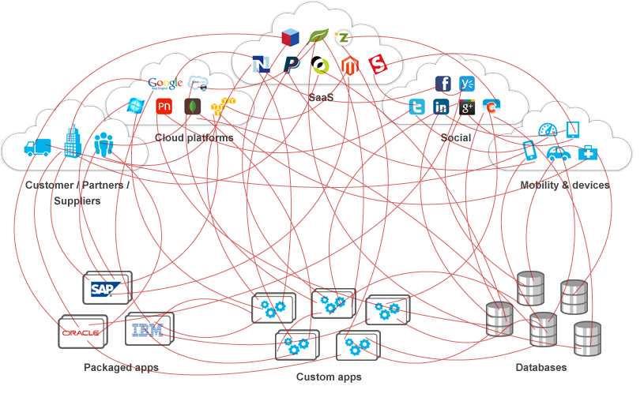
Chinasoft International
能力与创新中心
The Difficulties of Enterprise Architecture
改善员工的能力和生
Tight coupling and point-to-point links, Each system is fragmented, No centralized control
Poor adaptability, Unable to adapt to changes in protocol and message formats in new requirement.
Poor reusability, A service needs to develop multiple sets to serve a variety of applications
Monitoring and management deficiency, No data analysis to support decision
High cost and low efficiency, Long development cycle led to high costs and market opportunities deficiency
Notes:
Tight coupling • Communication link clutter • Cured transport protocol • Cured data format • Difficult to achieve message visualization • Dependent response to changing requirements, which constrains the rapid response of business opportunities, responded quickly to changes, and managing costs And maintenance costs continue to increase, but the effect is genera

Slide 6
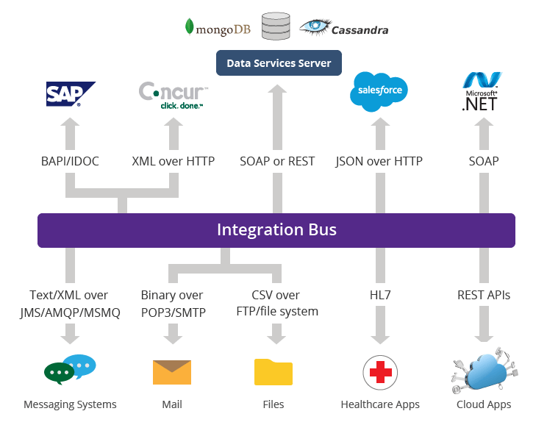
Chinasoft International
能力与创新中心
New Approach of Enterprise Architecture
改善员工的能力和生
Enterprise Service Bus:
Easy plug-in and plug-out Data Integration, ESB provides P2P Service integration, fragmentation eliminating and coupling reducing
Message Transformation, ESB provides message format converter and multiple transmission protocols in order to adapt the changes to demand.
Unified data integration platform, Conducive to centralized management -security and monitoring
More configuration rather than integration coding, low cost and fast launching
Enterprise Service Bus (ESB)
Notes:
ESB?
In order to solve the difficulties we encounter, the internationally accepted solution is through the ESB, that is, enterprise service bus. It is the traditional middleware technology and XML, Web services and other technologies combined product. ESB provides the most basic connection hub in the network, is to build the necessary elements of the enterprise nervous system. The emergence of the ESB has changed the traditional software architecture, can provide more than traditional middleware products cheaper solutions, but it can also eliminate the technical differences between different applications, so that different application servers to coordinate the operation, to achieve a different service Communication and integration.
Low coupling
P2P (Point-to-point) integration now all talk to the bus
Service reusability greatly improved:
More configuration rather than integration coding
Service scalability is greatly improved
Easy plug-in and plug-out

Slide 7
Chinasoft International
能力与创新中心
Key Benefits of ESB for Enterprise
改善员工的能力和生
Low cost and high efficiency
ESB makes smart decisions,
Data integration
Maintainability, scalability, and stability,
 | No ESB | ESB
Production launching | Long | Short
Architecture | Fragmented, Tight coupling | Centralized, Loose coupling
Development investment | More | Less
Operation and maintenance | Difficult to expand | Easy plug-in and plug-out
Reusability | Low | High
Market decision | Personal intuition | Data analysis
Enterprise cost | High | Low
Notes:
Low cost and high efficiency，On-demand computing services and High development efficiency make work flow Intelligent and automated.
ESB make smart decisions, Real-time analysis and big data support our decisions.
Data integration, ESB can easily integrate existing services and Cloud Service ,help enterprise implement business price.
Maintainability, scalability, and stability, ESB relies on the advantages of cloud computing to avoid the risk of a single point of failure, loosely coupled architecture to help expand and maintain.

Slide 8
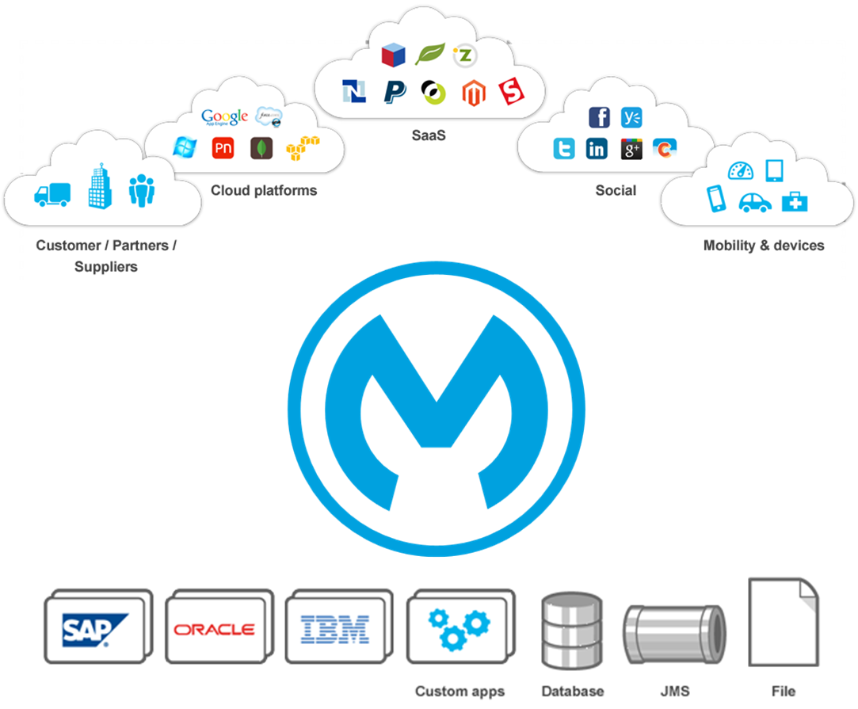
Chinasoft International
能力与创新中心
What is Mule ESB?
改善员工的能力和生
Mule ESB is a Java-based lightweight enterprise service bus and integrated platform that allows developers to quickly and easily connect multiple applications and support data exchange between applications. Mule ESB supports the integration of existing systems regardless of the underlying technology, such as JMS, Web Services, JDBC, HTTP, and other technologies.
The main features of Mule ESB are as follows:
Service intermediary
Data conversion
Message routing
Service creation and hosting
Notes:
The main features of Mule ESB are as follows:
A. Service intermediary The business logic and the message to send separation, shielding the service message format and protocol, to provide any location of the service call to provide protocol bridge. B. Data conversion Exchanging load content of information operations messages in different formats, including encryption, compression, and transcoding; and formatting messages between heterogeneous transport protocol data types. C. Message routing Based on the message content and complex rules routing messages, to achieve the message filtering, aggregation and reordering serial number. D. Service creation and hosting Exposure Endpoints, EJB, Spring Bean, and POJO as services, as a lightweight service container for hosting services.

Slide 9
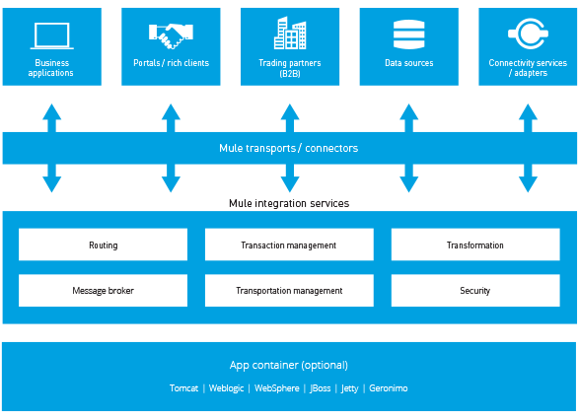
Chinasoft International
能力与创新中心
Why Mule?
改善员工的能力和生
Lightweight
Easy to use
GUI, less coding
Lots of connectors
Lifecycle support
Notes:
What is Mule ?
Mule， the runtime engine of Anypoint Platform, is a lightweight Java-based enterprise service bus (ESB) and integration platform that allows developers to connect applications together quickly and easily, enabling them to exchange data. It enables easy integration of existing systems, regardless of the different technologies that the applications use, including JMS, Web Services, JDBC, HTTP, and more. The ESB can be deployed anywhere, can integrate and orchestrate events in real time or in batch, and has universal connectivity.
Mule is lightweight but highly scalable, allowing you to start small and connect more applications over time. The ESB manages all the interactions between applications and components transparently, regardless of whether they exist in the same virtual machine or over the Internet, and regardless of the underlying transport protocol used.

Slide 10
Chinasoft International
能力与创新中心
Chinasoft Mule Ability
改善员工的能力和生
40+ Mule Certification
15+ Projects Delivered
Service Type
Architecture
Core Team
Experience
Training
Involving Industry
Project Development
Financial
Mobile
Traffic
11 members passed 1st
37 members passed 2nd
201 members is in progressing 3rd
Ability Training

Slide 11

Chinasoft International
能力与创新中心
Chinasoft Mule Training
改善员工的能力和生
01
Knowledge
Base
05
02
Qualification
Evaluation
Training
Course
Training
System
04
03
Practical Training
Technical Test

Slide 12
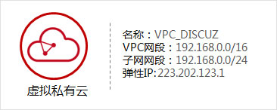
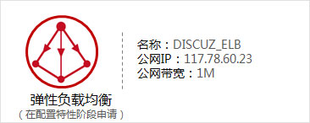
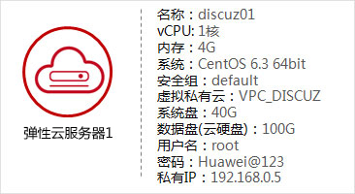
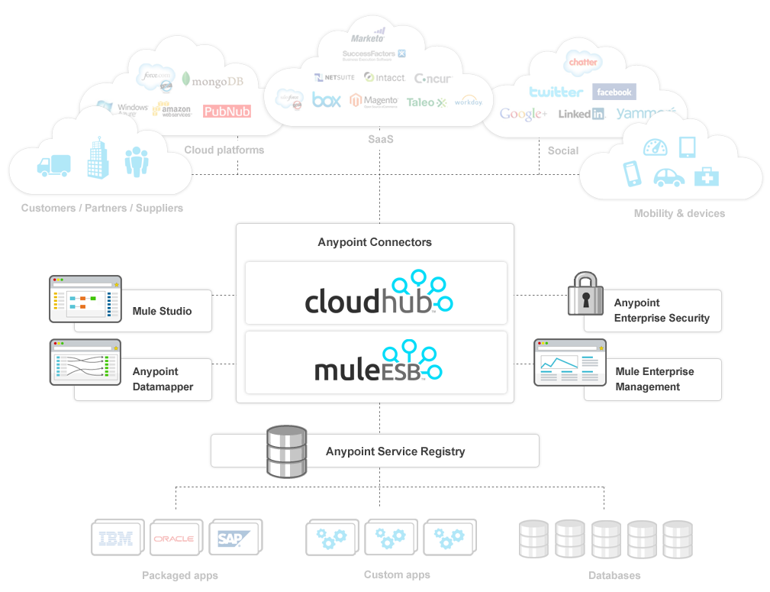

Chinasoft International
能力与创新中心
Capabilities on Huawei Cloud in Mule
改善员工的能力和生
Virtual Private Cloud(VPC)
Elastic Load Balance(ELB)
Elastic Cloud Server(ECS)
Cloud Operation
Managed Operation
Safety and maintenance integration
Cloud Migration
Legacy migrate to cloud platform
Value Added Services
Chinasoft Enterprise Cloud Drive
Cloud security solution

Slide 13
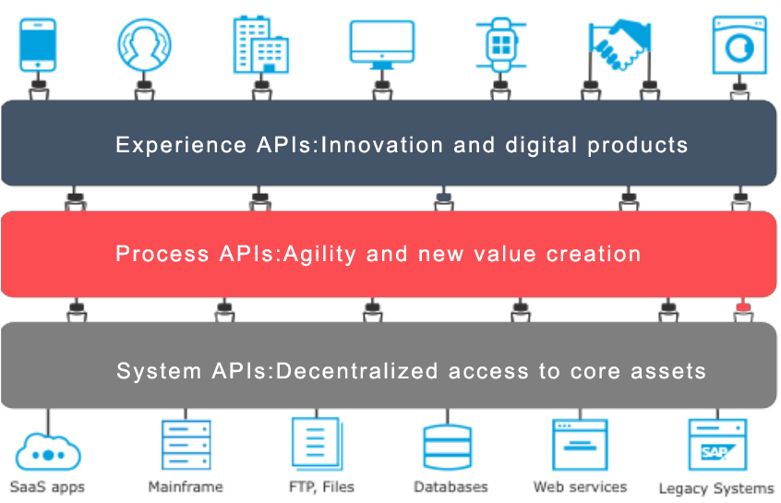
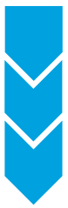
Chinasoft International
能力与创新中心
Achieve Business Value with Three Steps
改善员工的能力和生
1
Design
2
Process
3
Connect

Slide 14

Chinasoft International
能力与创新中心
MuleSoft
改善员工的能力和生
Connecting the world's applications, data, and devices.
Started in 2006
headquartered in San Francisco, California
2017 IPO
Anypoint Platform

Slide 15
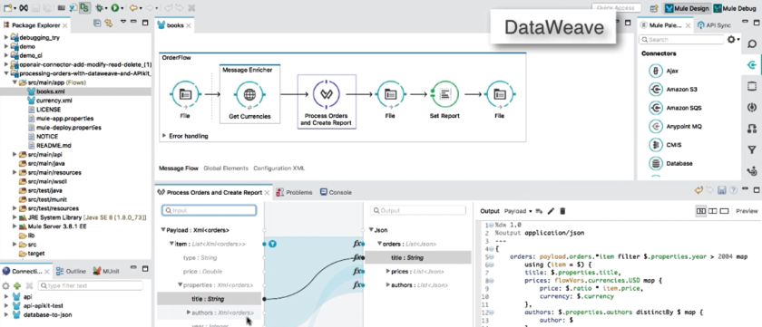
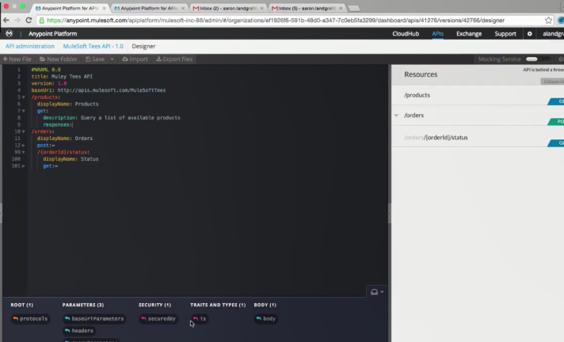
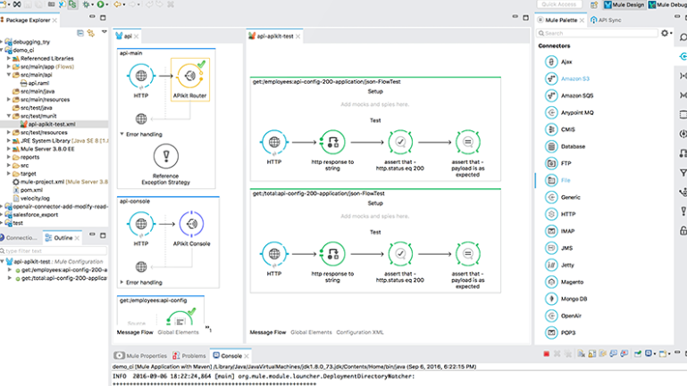
Chinasoft International
Design Center
能力与创新中心
改善员工的能力和生
Offers low-friction development tools that make it easy to design APIs, implement integration flows, and build connectors.
Collaborate on your API spec with easy-to-write and read RAML or import Swagger
Auto-generated console provides in-line and interactive documentation
Design according to best practices with a context-aware shelf
Validate designs before writing any code with the mocking service
Push, pull and sync RAML specifications with Anypoint Studio
Notes:
Anypoint Design Center
Offers low-friction development tools that make it easy to design APIs, implement integration flows, and build connectors.
What is Anypoint Studio?
Accelerate developer productivity with a single graphical environment for SOA, SaaS, APIs and data integration, then deploy your applications with one click to the Mule runtime, on-premises or in the cloud.
Design and implement APIs with unified tooling
Build, edit, document and debug integrations graphically or in XML
Simplify data mapping and transformation
Complete support for the entire build-to-deploy process
Jumpstart your integrations with pre-built components
Design APIs for consumption and reuse
API Designer provides a web-based graphical environment for designing, documenting, and testing APIs. Complete with a single-click mocking service, API Designer makes it easy to engage fellow coders, teammates and customers at multiple stages in the design process, helping teams validate early and deliver value with every new API-led connection.
Anypoint Connector DevKit
DevKit is a Maven-based tool, available in Anypoint Studio, that lets you build reusable components via a wizard-like experience to connect to any endpoint. These components can then be run as part of a Mule application on-premises or in the cloud and can be easily configured and consumed from Anypoint Studio.
What is MUnit?
Prior to deploying your Mule applications and APIs, conduct unit and functional tests using MUnit, a native testing framework for Mule. Test in your local environment, or in your continuous integration and continuous delivery (CI/CD) settings.

Slide 16
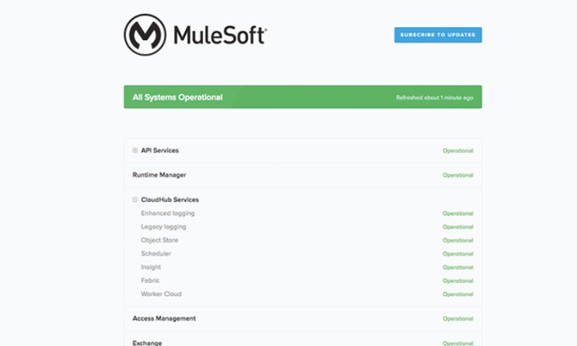
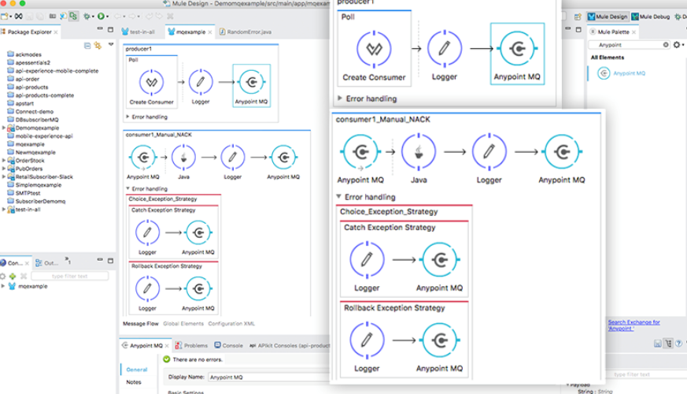
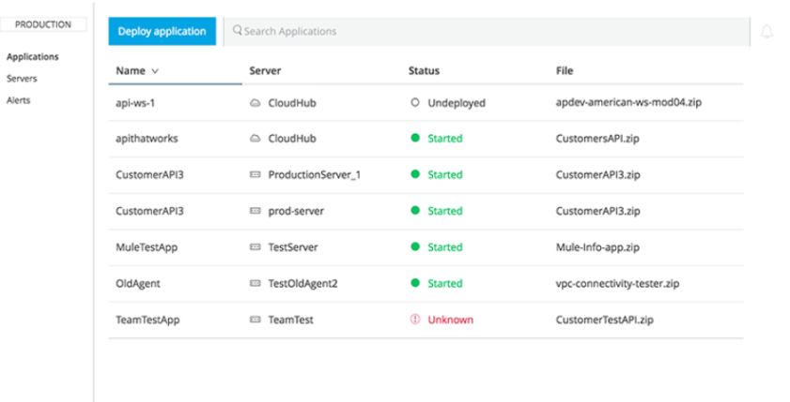
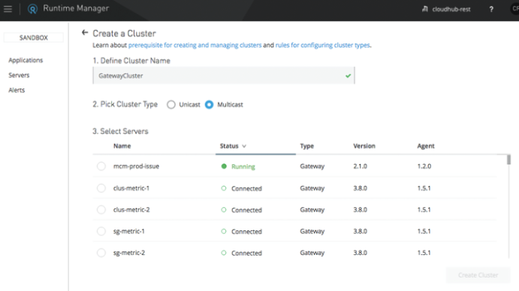
Chinasoft International
能力与创新中心
Runtime Services
改善员工的能力和生
This suite helps deliver enterprise­-grade security, scalability, reliability and high availability.
Single runtime deployable in the cloud or on-premises
Enables SOA, ESB patterns, SaaS connectivity, API management and micro services
Open architecture supports common standards and new technologies
Extensible to SOAP or REST, JMS or AMQP, AS400 or IoT
Compose in real-time, connect in batch, or do both if required
Map and transform data with highly maintainable and reusable DataWeave code
Notes:
Runtime services
Anypoint Platform shares a strategic set of runtime services for key functions, including reliability, resilience, availability, and scalability. These runtime services improve operational efficiency while helping organizations maintain security and control.
Anypoint Fabric
Instant Scalability, Reliability, Availability
Anypoint Fabric enables high availability, performance to hundreds of thousands of transactions per second, and scalability to hundreds of Mule runtimes deployed in a highly distributed hybrid environment.
Deliver turnkey reliable message delivery for both integrations and APIs
Automate failover and message persistence
Scale workers horizontally or vertically to handle peak workload
Anypoint MQ
With Anypoint MQ, perform advanced asynchronous messaging scenarios such as queueing and pub/sub with fully hosted and managed cloud message queues and exchanges. A service of Anypoint Platform, Anypoint MQ supports environments, business groups, role-based access control (RBAC) to help you deliver seamless customer experiences across channels and integrate devices reliably for Internet of Things (IoT) applications with enterprise-class functionality.
Scalable, asynchronous messaging delivered as a fully hosted cloud service
Turnkey secure, reliable message delivery
Easy connectivity to Mule application or non-Mule applications
Single pane of glass for runtime, API and queue management
Anypoint Enterprise Security
Ensure API-led connections are secured by design
Anypoint Enterprise Security provides an additional layer of capabilities on top of what is already available on Anypoint Platform for organizations and makes security features accessible to a broader range of skilled developers. A comprehensive suite of security capabilities, Anypoint Enterprise Security help developers fill gaps between trust boundaries in the application network.
Block unauthorized access to systems through filters and policies
Prevent exposure of sensitive data with encryption and digital signatures
Control access to APIs with proven security standards like OAuth2, SAML or LDAP
Anypoint Virtual Private Cloud
Connect hybrid architectures with confidence
With Anypoint Virtual Private Cloud (VPC), securely connect your corporate data centers and on-premises applications to the cloud as if they were all part of a single, private network. Choose from industry standard encryption standards IPSec or SSL, and secure your network at the hardware or software levels.
Create secure virtual networks within Anypoint Platform's PaaS component, CloudHub
Connect CloudHub to assets behind your firewall
Connect CloudHub to another public cloud
Deploy Mule runtimes anywhere, securely
CloudHub
The power of Mule, hosted and managed in the cloud
CloudHub is the platform as a service (PaaS) component of Anypoint Platform, providing a fully-managed, multi-tenanted, globally available, secure and highly available cloud platform for integration and APIs. With no hardware to maintain and continuous software updates, CloudHub delivers the benefits of true cloud-based integration.
Fully managed, fully hosted MuleSoft integration PaaS
Multi-tenancy for applications and workers improves efficiency
Globally distributed architecture delivers 99.99% uptime
Cloud security and compliance available out of the box
Control access based on complex organizational requirements

Slide 17
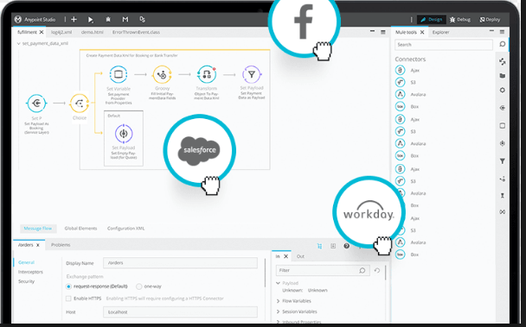
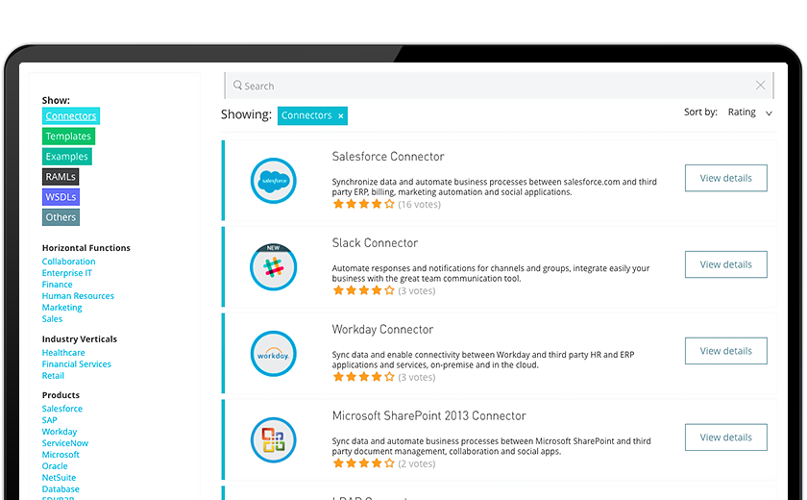
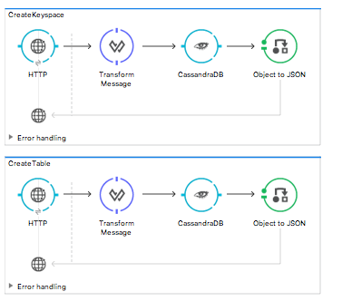
Chinasoft International
能力与创新中心
Anypoint Connectors
改善员工的能力和生
Out-of-the-box assets and tools you need to connect faster. Connect any endpoints with connectors from MuleSoft’s ecosystem, or by using dynamic connectivity to API specifications. You can even build your own reusable connectors with Anypoint Connector DevKit.
Pre-built generic protocol, transport and database, and application connectors
Quick connectivity to thousands of REST and SOAP APIs
Versatile generic protocol, transport and database connectors
Use DevKit to build a reusable connector for consistent use within your organization
Submit your connector for certification to embed your connector into MuleSoft’s ecosystem
Notes:
Anypoint Runtime Manager
Get actionable visibility, wherever resources are deployed
Anypoint Runtime Manager reduces the complexity of managing and monitoring hybrid environments by providing a single pane of glass for all resources deployed on Anypoint Platform. Once deployed, administrators can monitor the status and the state of deployments, view performance metrics across environments and connect to third party monitoring and operations tools to drive SDLC.
Deploy applications on-premises, in a private cloud or to CloudHub, MuleSoft’s PaaS
Cluster applications and queue messages for scale and reliability
Set alerts and respond proactively to eliminate resource constraints
Monitor key performance metrics across servers and apps to maintain system health
Replay transactions and trace data cross events to rapidly troubleshoot issues
Anypoint API Manager
Ensure every API is secure and governed
With just a few simple steps, API Manager enables you to manage users, monitor and analyze traffic, and secure APIs with ordered policies. Provide API management for every connection made to backend services and data sources with Mule runtime engine, a single runtime deployable as an integration engine and an API gateway. Wherever your APIs are hosted and whatever technologies they run on, API Manager lets you keep tabs on the APIs in your application network from one place.
Proxy existing services or secure new APIs with an API management gateway
Add or remove pre-built or custom policies at runtime with no downtime
Deliver access management through tiered SLAs
Provision access across individual clients or entire teams with OAuth and SAML
Set alerts and respond proactively to mitigate policy and SLA violations
What is Anypoint Analytics?
Track key metrics like API usage, transactions by region, and performance against SLAs for your APIs to better understand and improve service for your users. Or gain granular visibility into the business transactions and events for your Mule applications to quickly find and remediate issues.
Gain real-time insights into API performance, usage and errors
Create and manage custom dashboards and charts
Provide API metrics to the consumers of your APIs
Identify and analyze root cause of errors to recover quickly and prevent future issues
Anypoint Access Management
The Anypoint Access Management section shows you how to create your Anypoint Platform account or configure federated External Identity.

Slide 18


Chinasoft International
能力与创新中心
Benefits
改善员工的能力和生
Launch applications 3X faster
Make 300% more productive
Secure your IT assets
Reduce risk by API strategy
Deliver security by design
Reduce the risk of environ-ment and deployment.
Data reference Chinasoft Projects Analyst.
Notes:
Launch applications 3X faster
With Anypoint Platform, Cox Automotive is unlocking digital assets securely via APIs, making them discoverable and reusable across the organization for teams to experiment and launch brand new products. Under this new operating model, provisioning data access to business partners now takes seconds.
Make 300% more productive
Secure your IT assets
By 2020, Gartner predicts 60% of digital businesses will suffer major service failures due to the inability of the IT security team to manage digital risk in new technology and use cases. With Target, Apple, Nissan, and Twitter all making the news recently for their security failures, CIOs and CISOs are under tremendous pressure to keep the business secure -- without slowing the business down.That's why incorporating security by design into applications and services is so crucial for the enterprise.
在网络结点层面进行安全设计，
在api 细节层面保护IT数据资产
减少部署运维中间环节交互的风险。

Slide 19
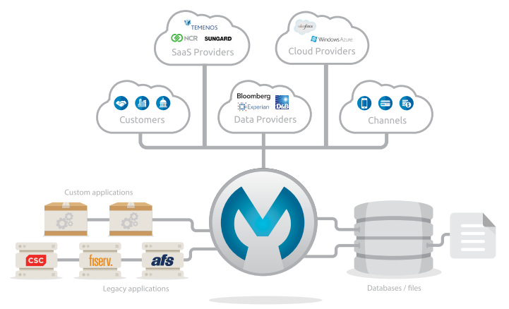
Chinasoft International
能力与创新中心
For Financial Services
改善员工的能力和生
Used by 35% of the Fortune 500 and 4 of the top 10 global banks.
Mule in Banks
Notes:
Anypoint Platform
For Financial Services
When it comes to modernizing infrastructure, financial services firms find themselves in a tight spot
trying to juggle competing and conflicting industry imperatives. Operational inefficiencies, disparate
systems, legacy technology and security concerns all stand in the way of launching new products and
capitalizing on new revenue opportunities. But clients still expect a seamless customer experience
across delivery channels, whether branch, call center, web, mobile or tablet.
MuleSoft enables firms to address industry imperatives, realize new revenue opportunities, and
deliver on customer expectations by modernizing their integration architecture with an open,
extensible platform for SOA, SaaS integration and APIs.
MuleSoft’s Anypoint Platform™ is the #1 integration and API management platform, used by 35% of
the Fortune 500 and 4 of the top 10 global banks.
Anypoint Platform for SOA:
Web services
Service orchestration
SOA governance
Anypoint Platform for SaaS:
App connectivity across on-premise and the cloud
Real-time data integration
Hybrid security
Anypoint Platform for APIs:
API management
API gateway
Developer portal

Slide 20
Successful Case - HSBC Digital Transformation
Background
HSBC IT Delivery Velocity
Mulesoft within HSBC and Chinasoft

Slide 21
Chinasoft International
Background
能力与创新中心
改善员工的能力和生活
Recent years, HSBC’s Digital Transformation Strategy is in progress like most of international banks in the world.
Various difficulties blocked the beginning, like infrastructures, architectures, technologies, engineers.
Dual-track approach - adopted traditional Java industry and actively explore outside parallelly.
Introduced Mulesoft technology and built its own technical platform which is based on Mule.

Slide 22
Chinasoft International
HSBC IT Delivery Velocity
能力与创新中心
改善员工的能力和生活

Slide 23
Chinasoft International
能力与创新中心
Mulesoft within HSBC and Chinasoft
改善员工的能力和生活
Advantages of Mule:
Much more easier to launch Agile development
Easier development and deployment makes everyone happy
Unified interface specification, communication always in the same page no matter what domains
Quick and consistent integration of various service systems
Chinasoft Mule engineering team grow up with HSBC projects.
Chinasoft have more than 150 engineers working on MuleSoft projects until 2017 Q2.

Slide 24
Vision

Slide 25
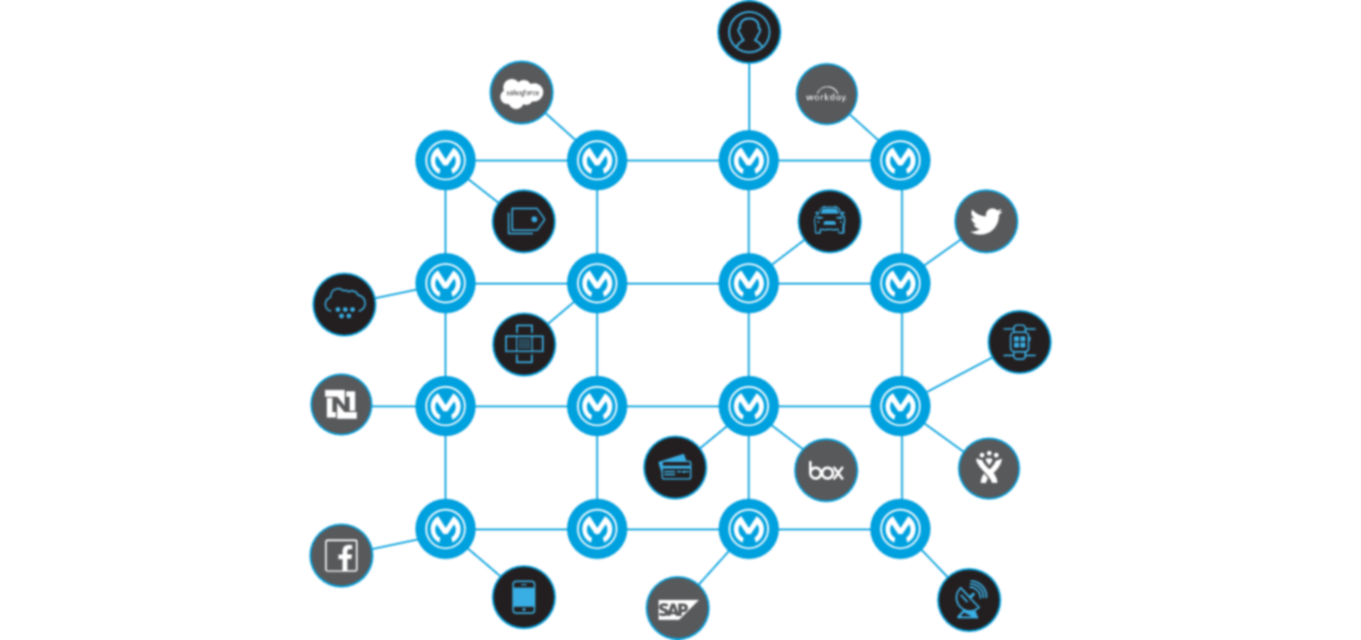

Chinasoft International
Vision
能力与创新中心
改善员工的能力和生活
Architecture
Service Type
Project Development
Ability Training
Notes:
Transform your business with MuleSoft
seamless frameworks of applications, data sources, and devices connected by APIs, whether on-premises or in the cloud. They speed up app launch and modification cycles, make it easier to secure and manage access, and ultimately enable companies to do more — and faster — with less.

Slide 26
Thank you

